Slide 1
PREPARING FOR YOUR END OF TERM PRESENTATION

Slide 2
Overview
Why?
What?
Who?
How?

Slide 3
Why do a final presentation?
Gives you an opportunity to showcase your work
Provides another form of evaluation for Lutron
Provides an additional opportunity to interact with leaders at Lutron

Slide 4

What is being evaluated?
Technical knowledge of topic and your ability to clearly communicate that knowledge
Understanding of the ‘why’ behind your project
Ability to present to a group
How do you handle the unpredictable
Notes:
Can you explain what you are working on properly?

Slide 5

Who is the audience?
Your audience will be people with your technical background, but not people on your direct team:
3 reviewers, 2 manager level

Slide 6
Presentation Prep
Format
There is no right/wrong way of presenting
Most students use PowerPoint
Some students get creative with Java, iOS, etc., but make it can work within Teams
Physical prototypes and demos are encouraged
If you have an issue, tinker for 1-2 minutes to fix, then move on

Slide 7

Presentation Prep
Logistics
Book reviewers for 1.5 hours minimum
Presentation should be about 50 minutes
Anticipate 30 minutes of Q+A
Your presentation should be the 2nd to last week of your term
This provides enough time to follow-up on action items

Slide 8
Presentation Prep
Content
Presentation should focus on your main project
80% Project details
20% What you enjoyed
Work with your supervisor to understand the appropriate level of detail
Come prepared with in-depth data if needed
You should try to talk about small projects if you have the time

Slide 9

Presentation Prep
Sample Agenda
Quick intro about yourself
Problem statement – define your project
Provide data and information on how you solved the problem
Summarize the solution
Q+A

Slide 10
Presentation Prep
Tips
Utilize a variety of different displays to keep it interesting (pictures, text, charts)
Reach out to your reviewers before sending the formal invite to your presentation
Provide your background, team, project
Provide an agenda/outline of presentation

Slide 11
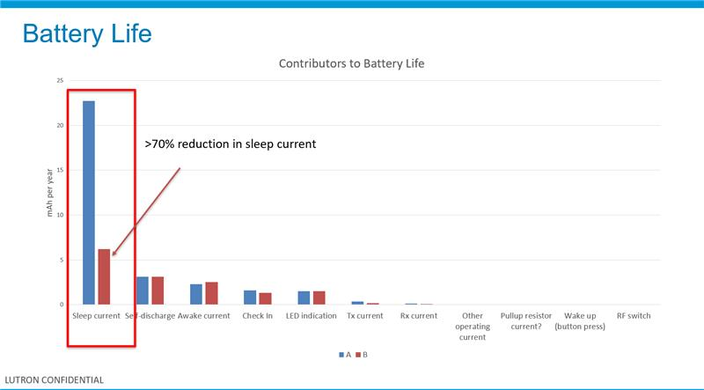
Data Visualization Examples

Slide 12
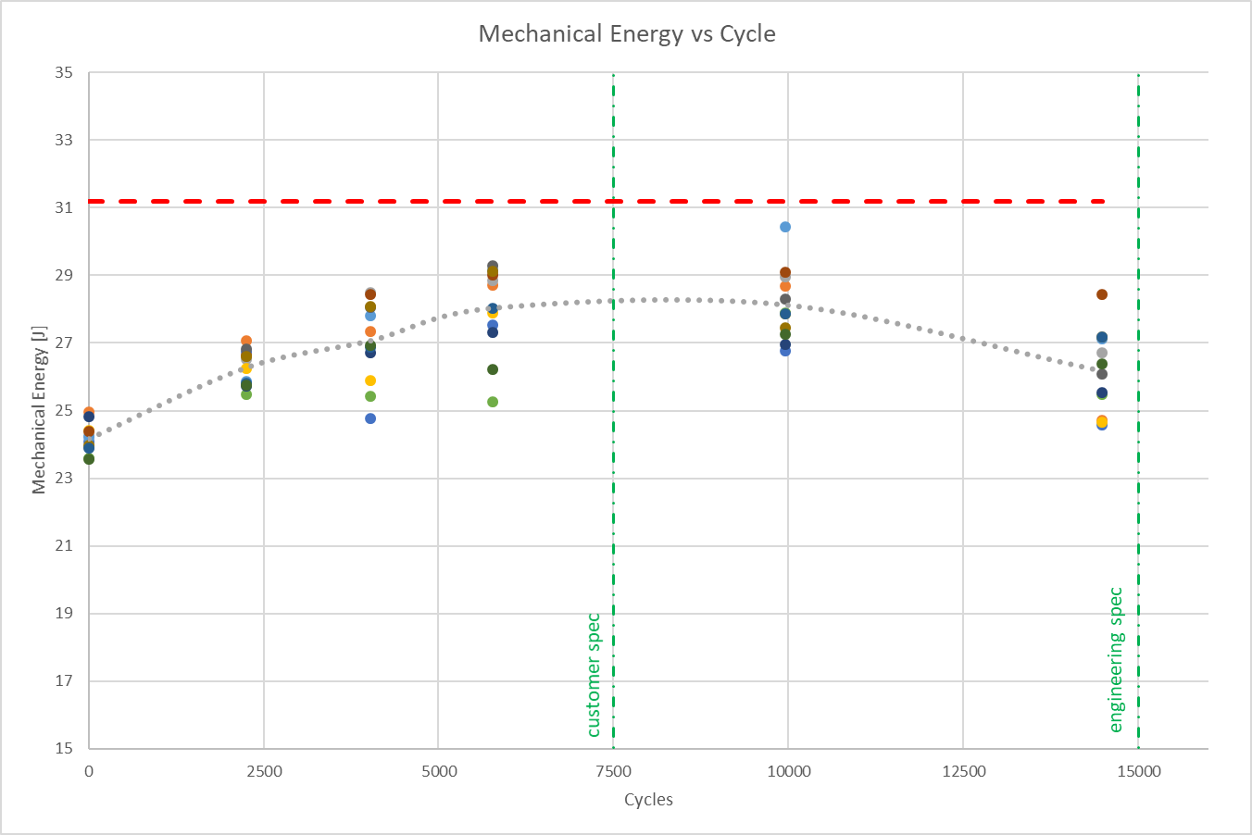
Data Visualization Examples

Slide 13
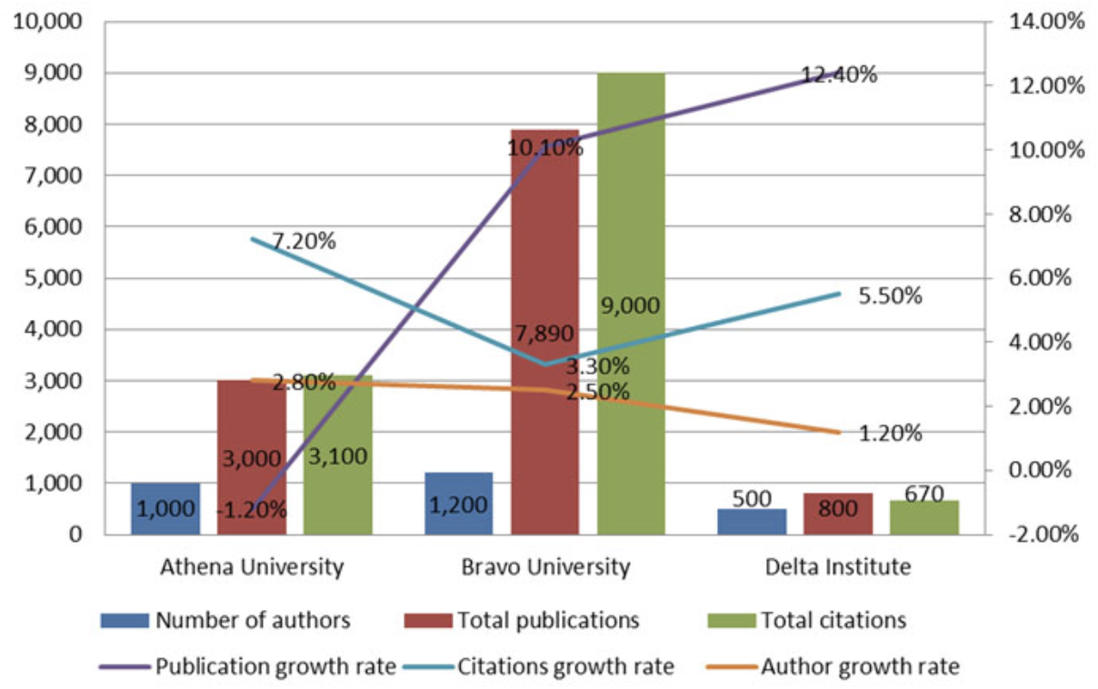
Data Visualization Examples

Slide 14
Rules of Thumb
Highlight important data visually
Keep it clean and focused!
Avoid using more than one axis
​Label axes and datasets (legends)
Remember your audience
“Clear” your charts

Slide 15

Giving the Presentation
Treat this like an interview
Arrive early to make sure equipment works
Understand the big picture of your work
Notes:
Reinforce how important their presentation is – people in the room / reviewers treat this as an interview

Slide 16
Giving the Presentation
Tips
Don’t say: “because my supervisor told me”
Understand the WHY
Don’t be rigid, its okay to stray from your presentation for a little while
Be sure to capture action items and follow-up
Don’t talk too fast
Have fun!

Slide 17
What’s next?
1.
Schedule your presentation
2.
Prepare
3.
Practice

Slide 18
QUESTIONS?

